Slide 1


Slide 2


Slide 3
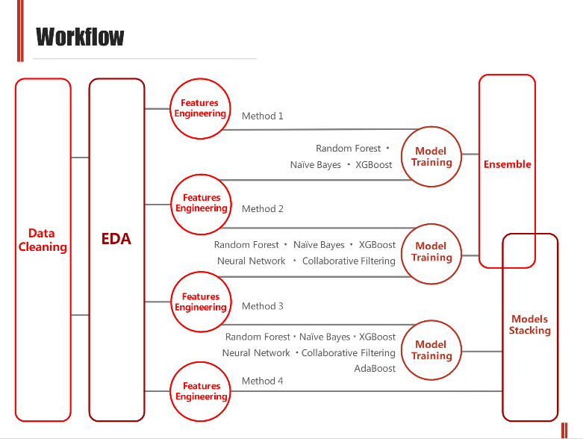

Slide 4
HouseStyle | MSSubClass | 5 | c | 房屋建筑类别 | partial correlated | could be represented by MSSubClass |  | selective remove
MSZoning | Neighborhood | 3 | c | 土地类型 | partial correlated |  | extract rm as single col
LotFrontage | multi columns | 2 | n | 街边长度 | slight correlated
LotArea | area related | 2 | n | 土地面积 | slight correlated | Should have higher correlation with price?
Street |  | 0 | c | 街类型 |  | two cate, one only contain 6rows |  | remove
Alley | neighborhood | 2 | c | 胡同 | partial correlated | >80% missing data, have same feature as Street
LotShape |  | 1 | c | 土地形状 | correlated
LandContour | landslope | 4 | c | 土地平坦度 | not correlated | could be represented by landslope |  | consider to remove
LandSlope | LandContour | 4 | c | 土地角度 | not correlated | could be represented by LandContour |  | consider to remove
Utilities |  |  | c |  |  | no use |  | remove
LotConfig |  | 1 | c | 土地外形 | partial correlated
Neighborhood | MSZoning | 3 | c | neighbor相关 | partial correlated | too many cate | might do more reserch on this col or remove | consider to remove

Slide 5
Missing Data
LotFrontage: Use median LotFrontage of the HouseStyle instead of Neighborhood.
MSE:
BldgType, MSZoning : 682
Neighborhood: 641
MSZoning, HouseStyle: 574
HouseStyle: 515

Slide 6
Feature Engineering
Exterior2
Condition2
BsmtFinType1
Assign a value if equal to Exterior2nd and Condition2

Slide 7
Feature Engineering
MiscVal:
Subtract from original data set and add it back in our resault.

